Slide 1
Credits
הנדסת מערכות מידע
סגל הקורס סביבות פיתוח:
ד"ר ארז שלום
מר אדיר סולומון
גברת פרומרמן שיר
Present Simple:
Shaked Eyal
Tal Ben-Senior
Elior Nehemya
Alex Kremiansky

Slide 2
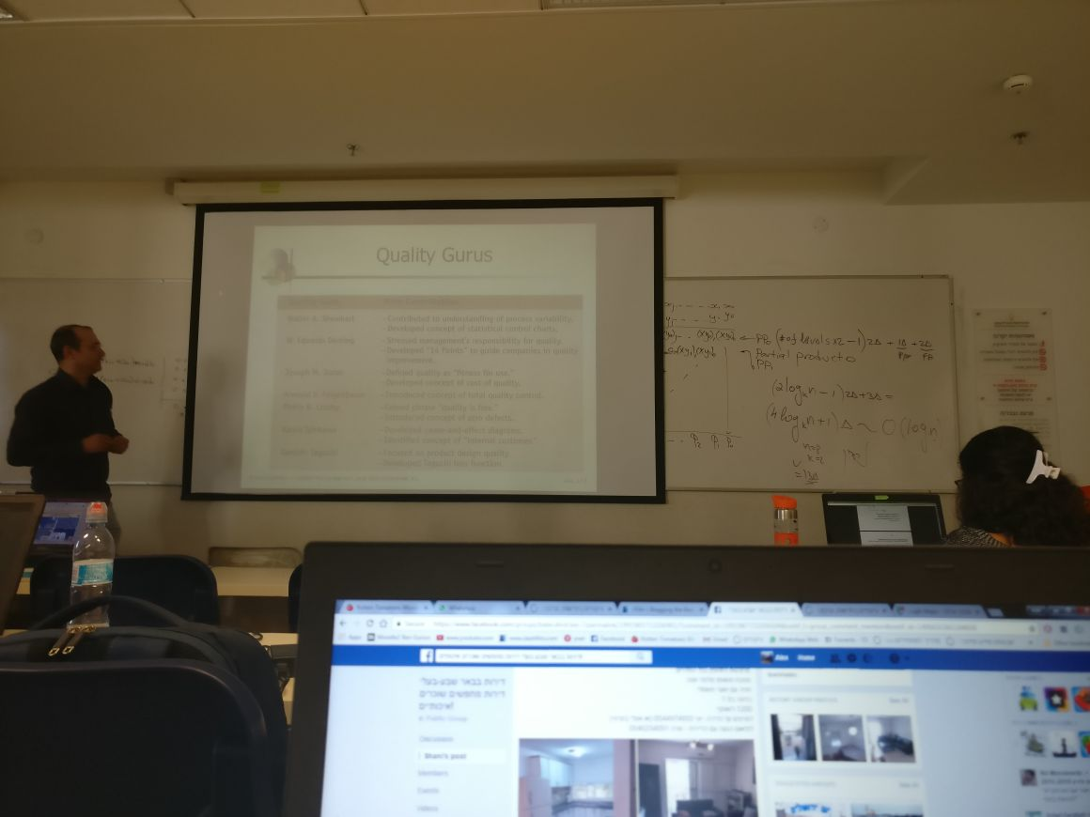

Slide 3
Problems with Academic Presentations Today
Mostly Text
No real-world context
Too Narrow

Slide 4
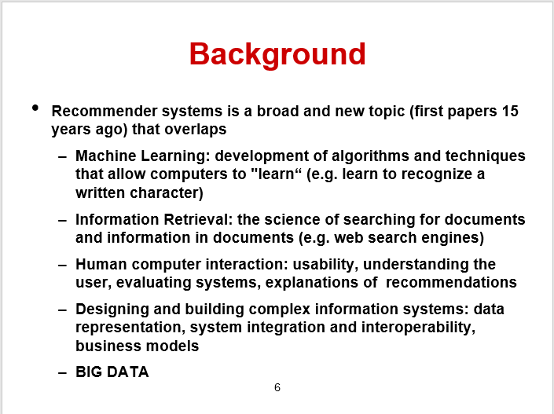

Slide 5
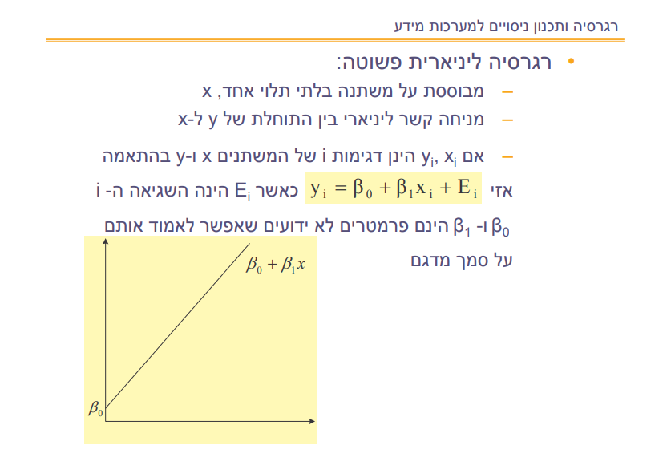
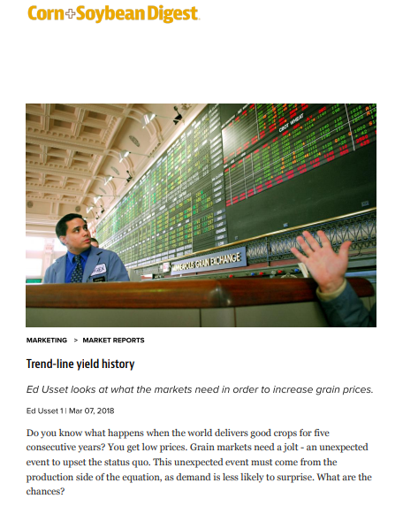
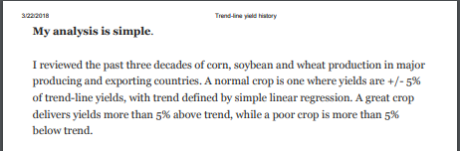

Slide 6
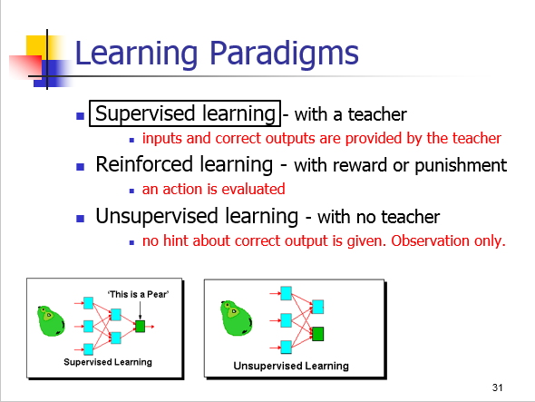

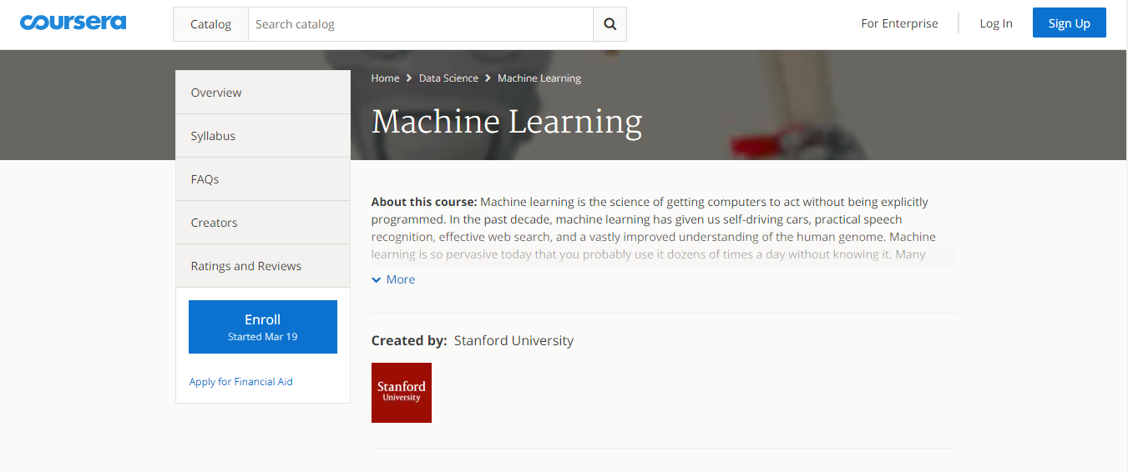
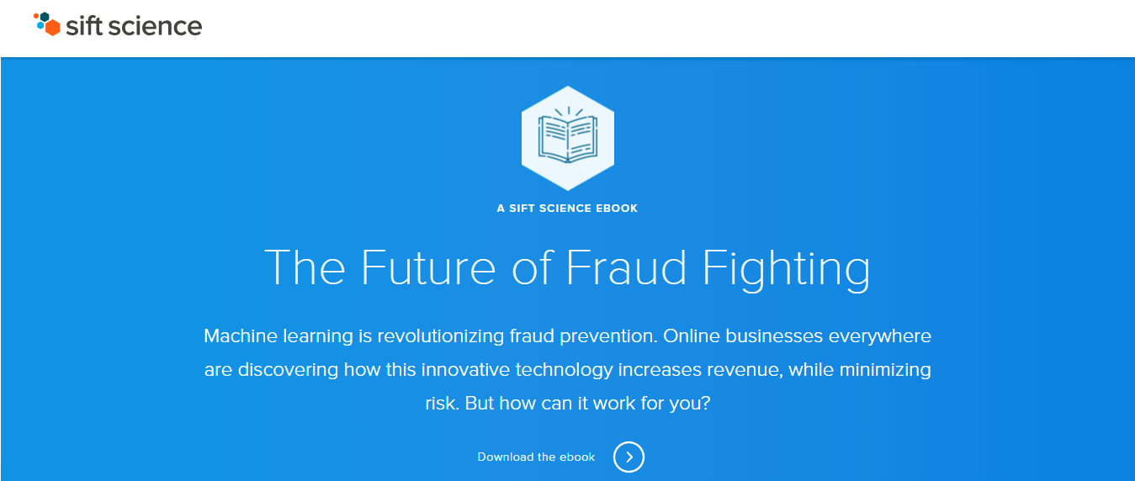
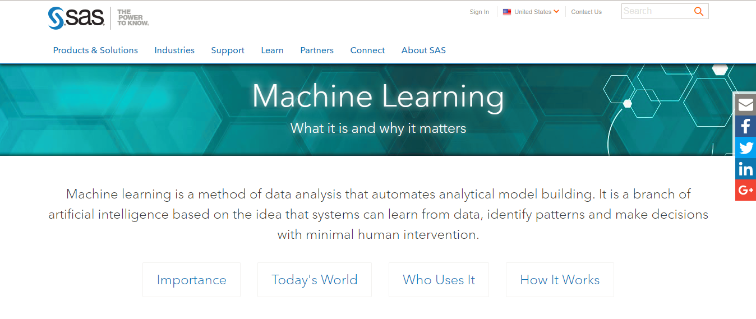

Slide 8
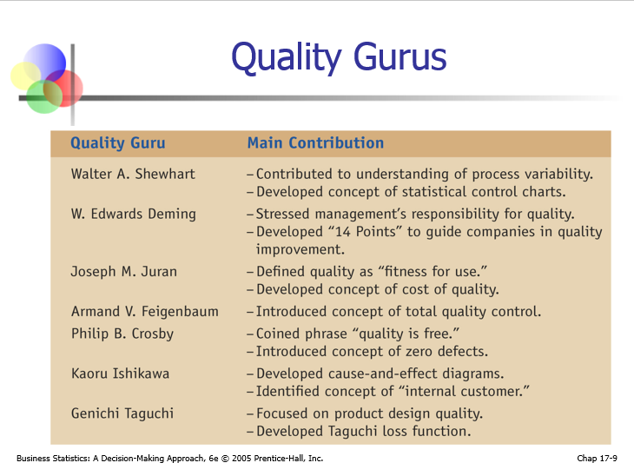

Slide 9
Our process is easy
first
Analyze The Slide
second
Find Interactive Content
last
Inject it back to the Slide

Slide 10

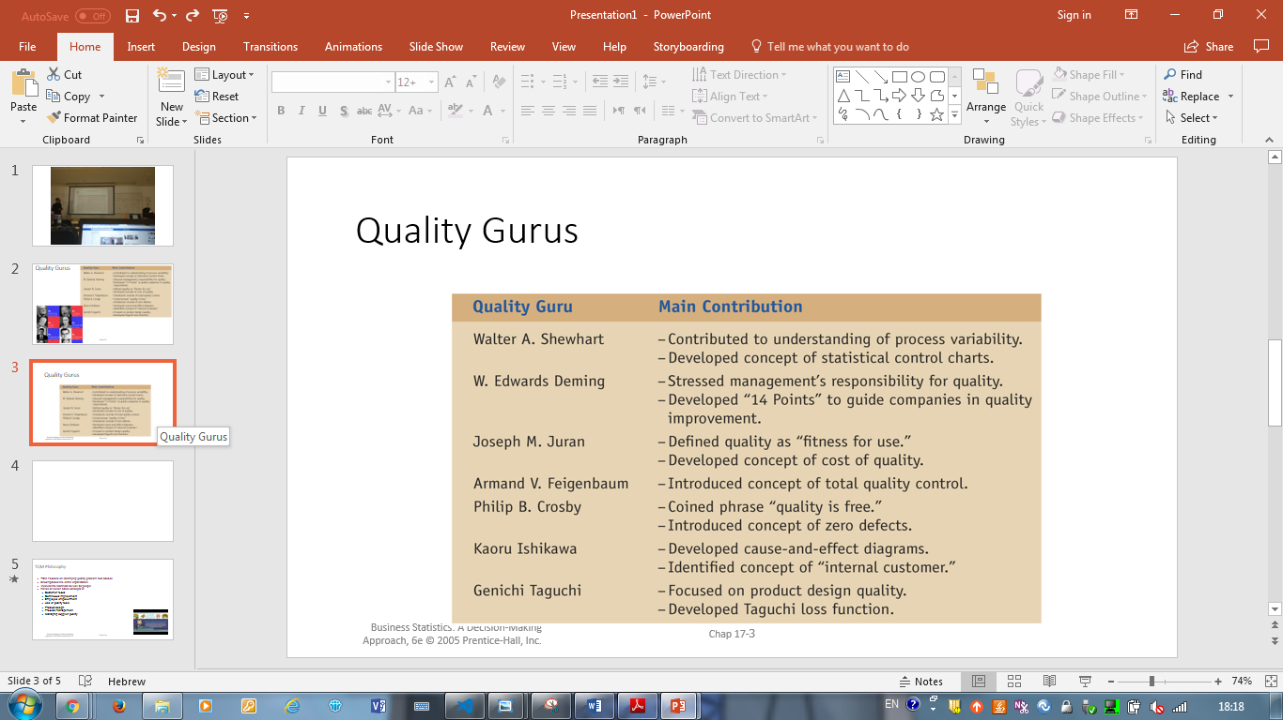

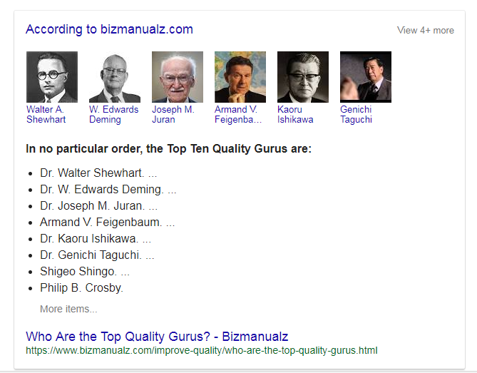
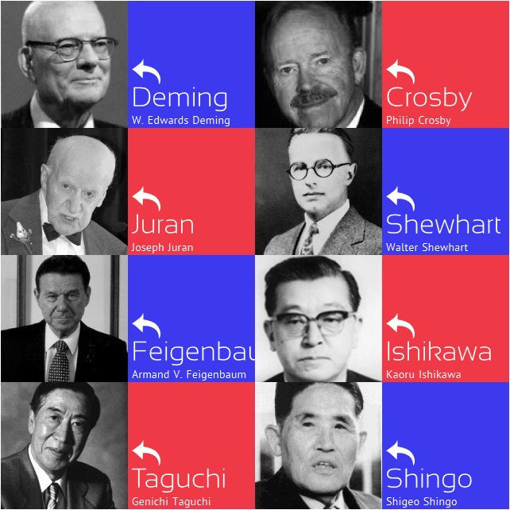
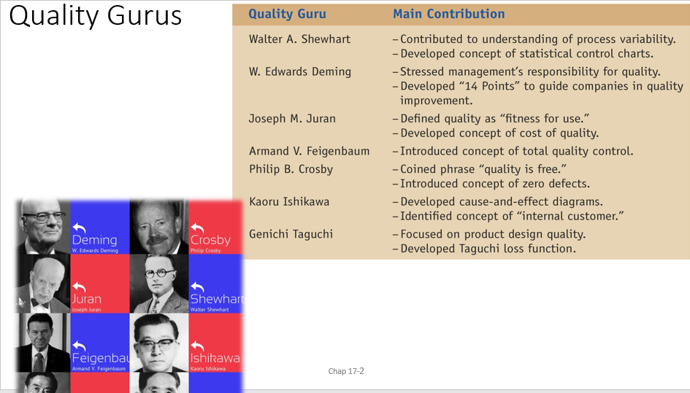
Before
After

Slide 11
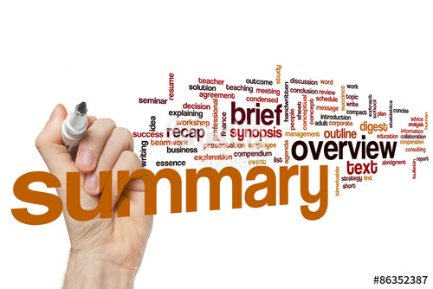
Present Progressive
Our Vision
Create an ENTIRE presentation based on a summary.

Slide 12

Present Perfect
Far Future
Create an ENTIRE presentation based on an ARTICLE.

Slide 13
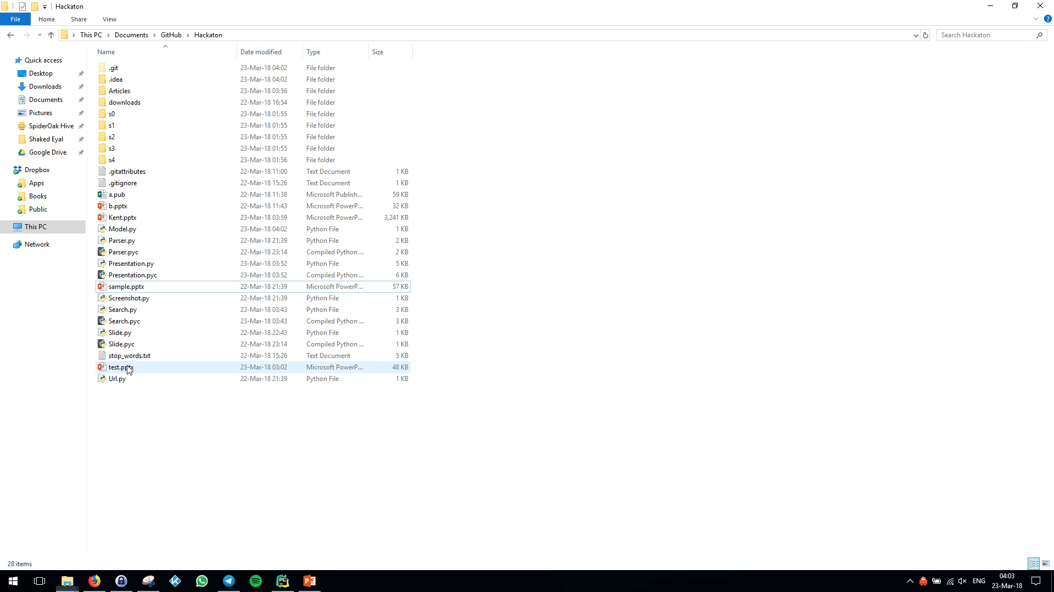

Slide 14
Thanks!
Any questions?
You can find me us @ 96

Slide 15
Credits
The DRYERS:
Shaked Eyal
Tal Ben-Senior
Elior Nehemya
Alex Kremiansky

